Slide 1

TASKTRACKER (MTT)
How to use Replication feature
October, 2011

Slide 2
Manufacturing Task Tracker
Manufacturing Task Tracker (MTT) is the centralized program for entering and managing corrective actions and tasks for Health, Safety, Environmental, Reliability, and Quality for facilities.
Many tasks are assigned to facilities by EHS Corporate which requires administration of which site has completed the item. A replication feature has been added to MTT to assign and manage this type of activity. Task Header template with Tasks are created and then replicated to selected divisions and/or facilities.
EHS management will set the policy on usage of this tool as overuse may dilute the usefulness of MTT.
LIFE recommendations
Environmental Regulations
Future: Environmental Quarterly Compliance
Lessons Learned from Incidents
2

Slide 3
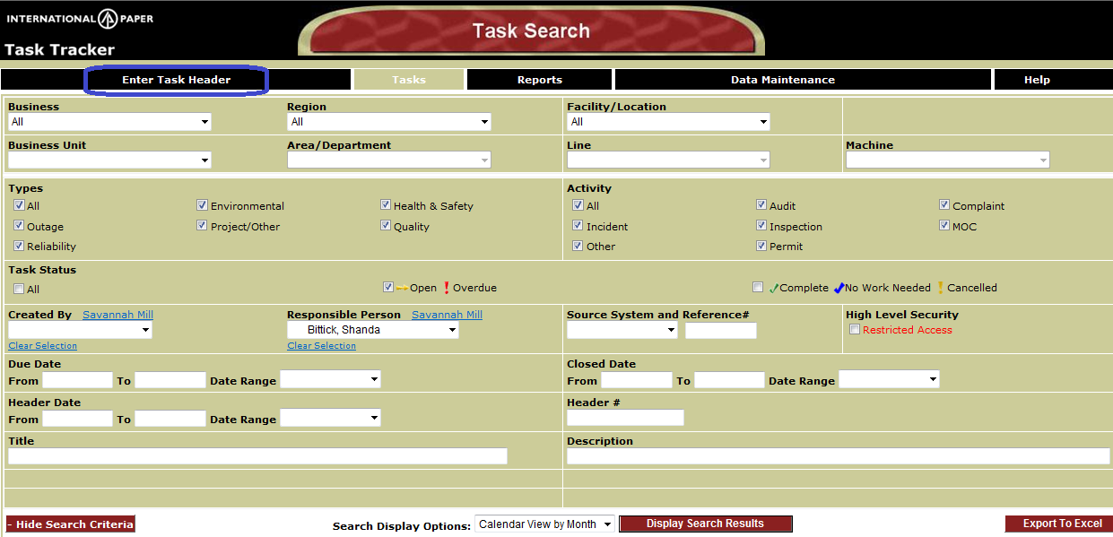
How to Create Replication Template
Access TaskTracker by typing “Tasktracker” in Address bar of Internet Explorer
Click on “Enter Task Header”

Slide 4
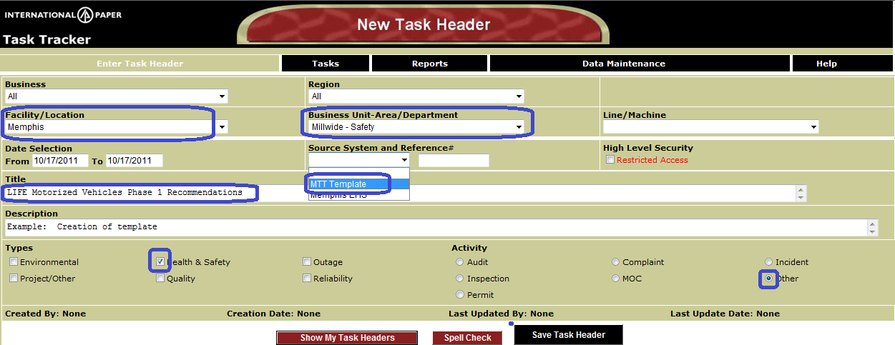
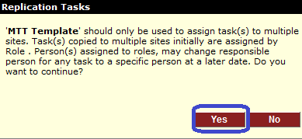
Enter an Task Header Template Information
Select:
Facility/Location (Keep this as Memphis)
Choose applicable Business Unit/Area(s) - Most likely Mill wide – Environmental or Safety
Start and End date and time: Can leave as default
Type Title (less than 80 characters used on reports and to find for updating)
May enter more information in Description
Choose applicable Types (Environmental, Health & Safety)
Choose Activity
SELECT Source System as MTT Template.
Will receive message to verify to continue. Choose Yes
SAVE TASK HEADER

Slide 5
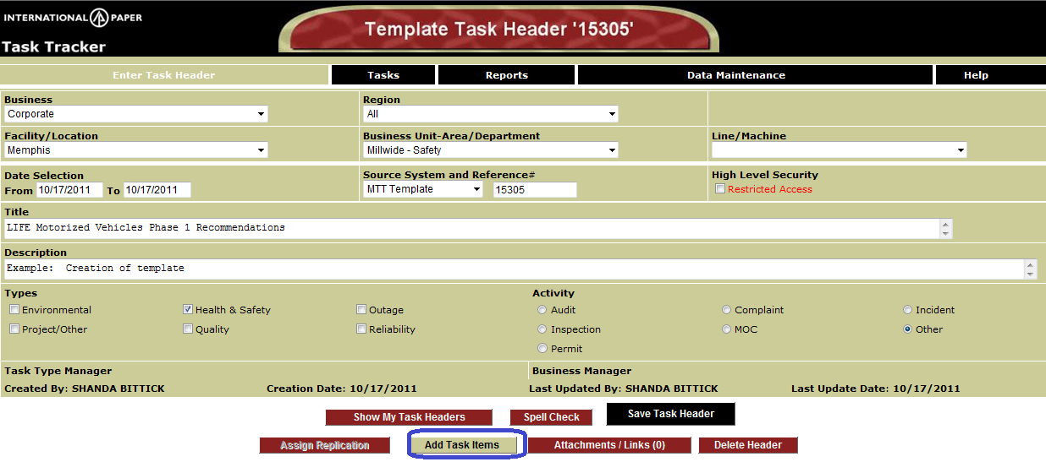
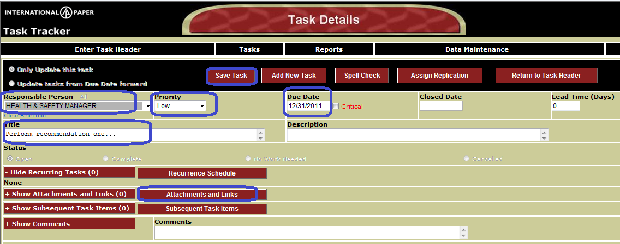
Begin Adding Tasks
Click on Add Task Items button and begin adding Action Items
Create Tasks
Responsible Person – Select role
Priority (Default = Low)
Due Date
Title of Task
May add attachment of link
Click on Save Task
7) To add additional task click on Add new Task and repeat
All tasks must be assigned to a ROLE (example: Environmental Manager). Role information is managed by the facility where they can assign one or multiple specific names.
When all tasks to replicate have been added, click on Assign Replication

Slide 6
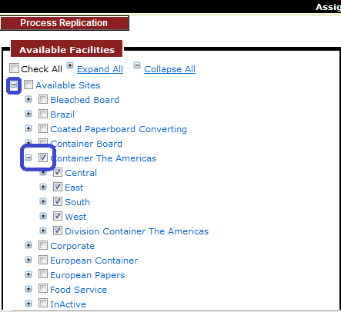
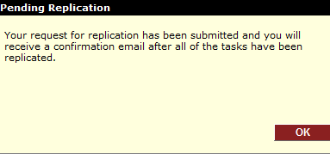
Replicate Template
Once template is replicated , verbiage and dates can not be modified, so verify that ALL information is correct (role assigned to task, description of task, due date, links). You may save and replicate at later time. (See Slide 8)
Replicate:
Expand divisions to assign tasks
Can select entire division by checking division box
Example: Container the Americas
Can select specific sites.
When finished selecting sites to assign tasks, click on Process Replication (at top)
Receive a message that replication submitted and will receive an email with any warning or errors when creating.

Slide 7
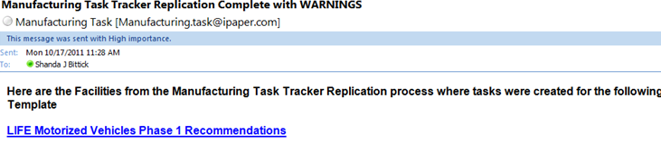

Example: Email from Replication
Email will be sent to confirm that tasks replicated correctly
From Manufacturing Task Tracker Replication Complete with Status
Status Sections:
Failure (Contact IT Help desk)
Warnings (No specific person at that site configured for that role). Need to contact site to update roles.
Successful

Slide 8
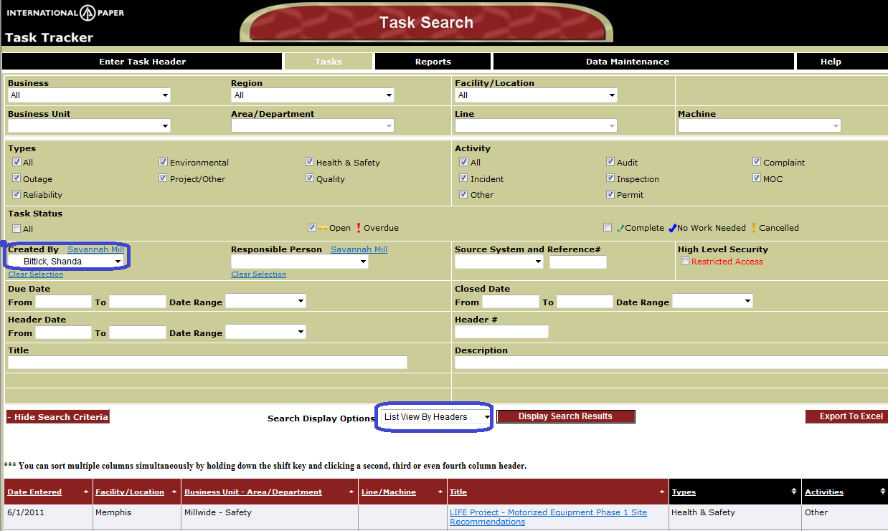
How to add more sites after initial creation of template
This feature useful to initially create Template and then review with others before assigning to sites or to use to assign to additional sites.
Open Task Tracker.
Change Created by to your name to find ones created by your OR Select Source System = “MTT Template” to find all Templates
Change Search Display Option to “List View by Headers”
Select MTT Template that you would like to replicate for additional sites.

Slide 9
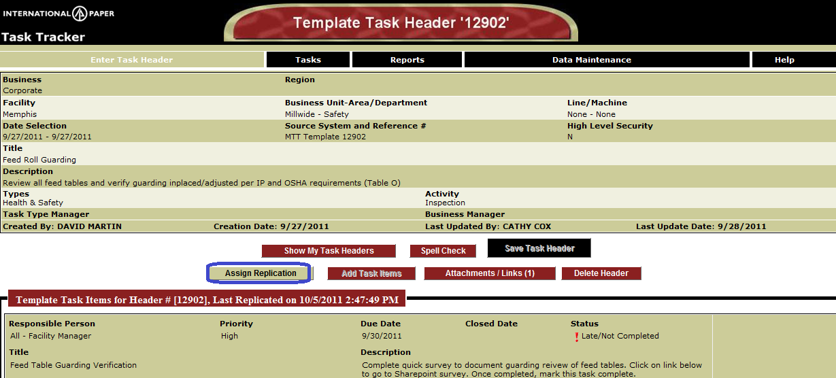
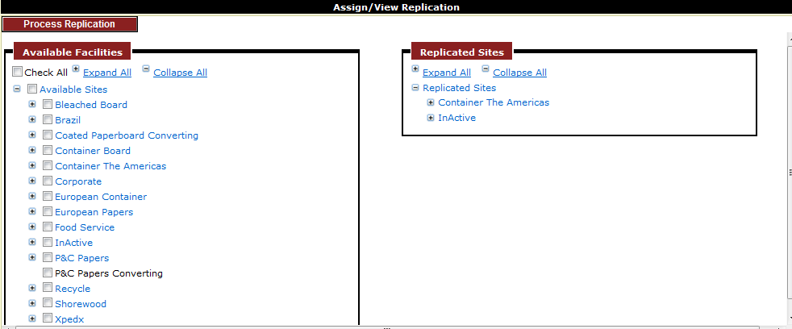
How to add more sites and replicate
Verify that this is the Template Task Header to replicate
Select Assign Replication
Sites already replicated will display
on left side. Sites that can be added
Will be on right side.

